Slide 1
Smart Cities Summit
Human-Centric Approach of Smart Communities
Verizon Smart Communities & Venues
Majid Khan – Managing Director
April 18, 2017
(Draft 1.1 – Deck Due to Lauren Lewis LLewis@harrisburgu.edu on April 7th

Slide 2
Proprietary Statement
This document and any attached materials are the sole property of Verizon and are not to be used by you other than to evaluate Verizon's service. This document and any attached materials are not to be disseminated, distributed or otherwise conveyed throughout your organization to employees without a need for this information or to any third parties without the express written permission of Verizon.
Verizon makes no representation regarding your use or ability to use any product or service under any applicable legal or regulatory requirement. This document and any attached materials do not constitute a legally binding agreement or offer to contract. Verizon reserves the right to make any corrections necessary for accuracy and completeness, and the descriptions of products, services, practices and policies herein are subject to change. Verizon disclaims any and all liability for any damages of any kind associated with its inability to perform or provide any services proposed in this document. Any features, functionality and pricing are directional and for discussion purposes only. Actual pricing, benefits, revenues and cost savings are not guaranteed and will depend on various factors, including customer network architecture and configuration, market conditions and regulatory environment. Verizon makes no representation that it can or will provide any service, software, equipment, installation, maintenance, management or other services.
© 2017 Verizon. All rights reserved. The Verizon name and logo and all other names, logos and slogans identifying Verizon's products and services are trademarks and service marks or registered trademarks and service marks of Verizon Trademark Services LLC or its affiliates in the United States and/or other countries. All other trademarks and service marks are the property of their respective owners.

Slide 3
Rapid Urbanization Brings Challenges
Need to
improve city infrastructure and services
Need to become more sustainable and lower carbon footprint
Need to make cities more livable to attract business and talent

Slide 4
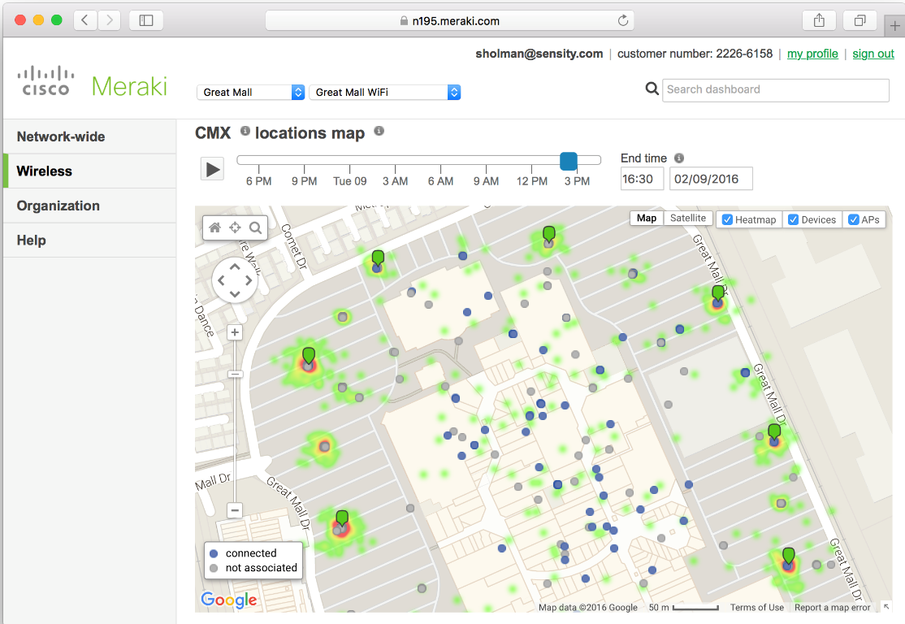
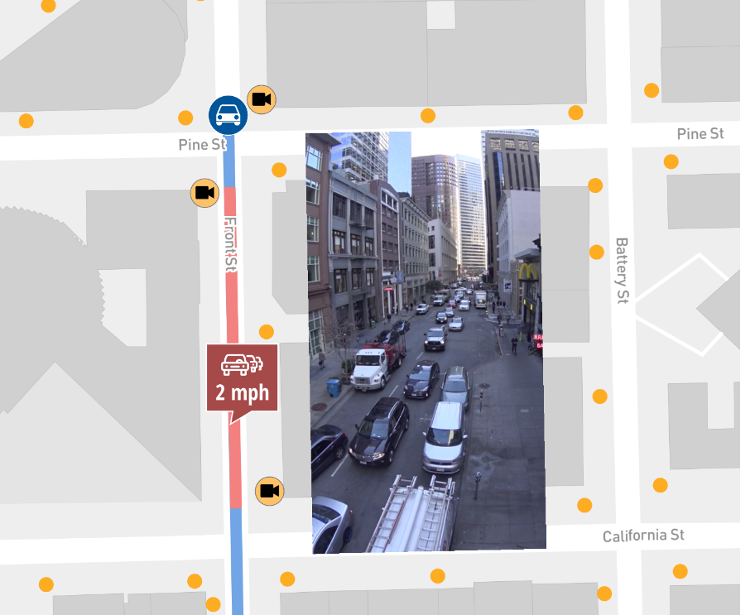
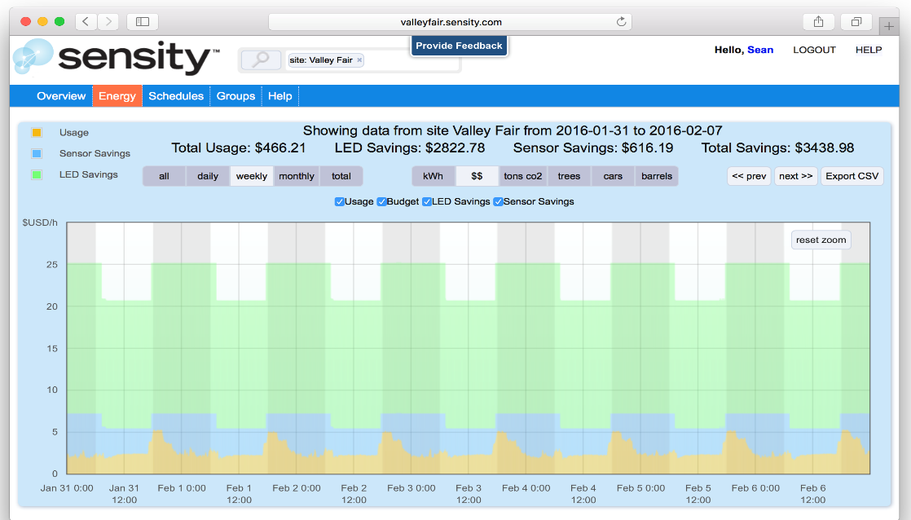
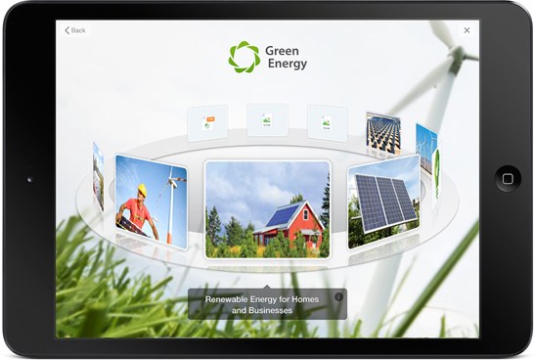
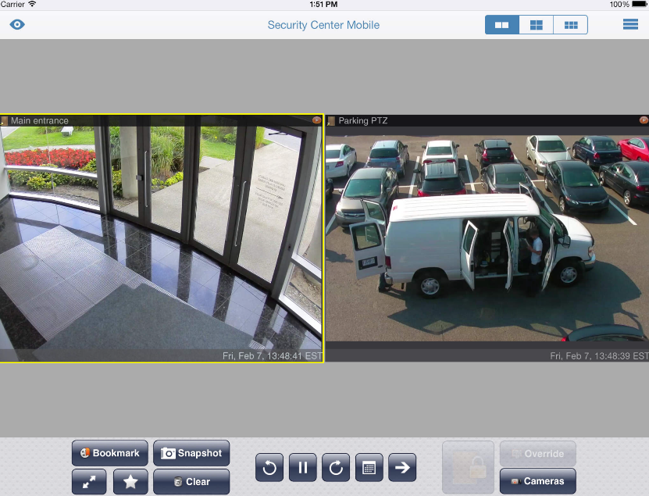
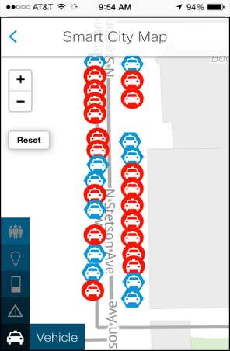
Top Ten Challenges that Smart IoT Solutions Solve For
1
Public Safety/Security
2
City Network (Public Wi-Fi – Emergency Services)
3
Parking (compliance and enforcement)
4
Traffic monitoring and management
5
Better lighting, lower energy costs/maintenance
6
Nuisance identification: graffiti, abandoned vehicles, illegal dumping, copper theft
7
Retail analytics for brick and mortar stores
8
Real-time infrastructure status: asphalt and potholes, refuse collection
9
Snow level reporting/plowing guidance
10
Environmental monitoring

Slide 5
Instead – What You Need To Build a Smart City Is…
One Global IoT Platform:
Leverage the same platform for many services and apps
Collect and analyze sensor data across one city platform so they can be correlated and measured
Build on an open standards platform for lower cost, scalability and future expansion.
Foster economic development by attracting new businesses, growing existing ones, and creating new jobs
Improve sustainability through reductions in energy use and greenhouse gas emissions, among other efforts
Engage with citizens, businesses, and community groups as active partners in city operations and decision-making
Develop a partnership ecosystem with like-minded vendors, universities and colleges, utilities, and other organizations to produce new products and services for constituents
Take an innovative approach to improving the quality of life for residents, solving long-standing urban challenges
A partner who can design, deploy and maintain it
“If you can’t measure it, you can’t manage it”
Information from IDC Government Insights 2014 White Paper.

Slide 6
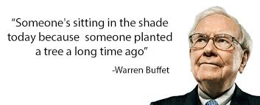
What does it take to deliver a Smart City?
…this is Different
Passion
Smart City Experience
Community Focus
Team Philosophy
Long Term Investment
6

Slide 7
Minimize Risk
Serving Communities through One Verizon.
Serving Citizens
Affordability/ New Rev Sources
Verizon Smart Communities
Security & Data Protection
ThingSpace, Analytics & Ecosystem
Prof & Managed Services & SI
Verizon Smart Communities
Holistic Customer Experience
145M CITIZENS
Consumer
Advertising
SMB
Lighting, Traffic Mgmt
& Parking
Economic Dev. & Citizen Engagement
Video &
Security
Requires Partnership to DELIVER a
Smart Community
Digital Signage
Street Level Solutions
Developer / Innovation
Venues
City Control Nodes / Sensors
Fiber
Small Cell
4G / Future 5G
Connectivity
7

Slide 8
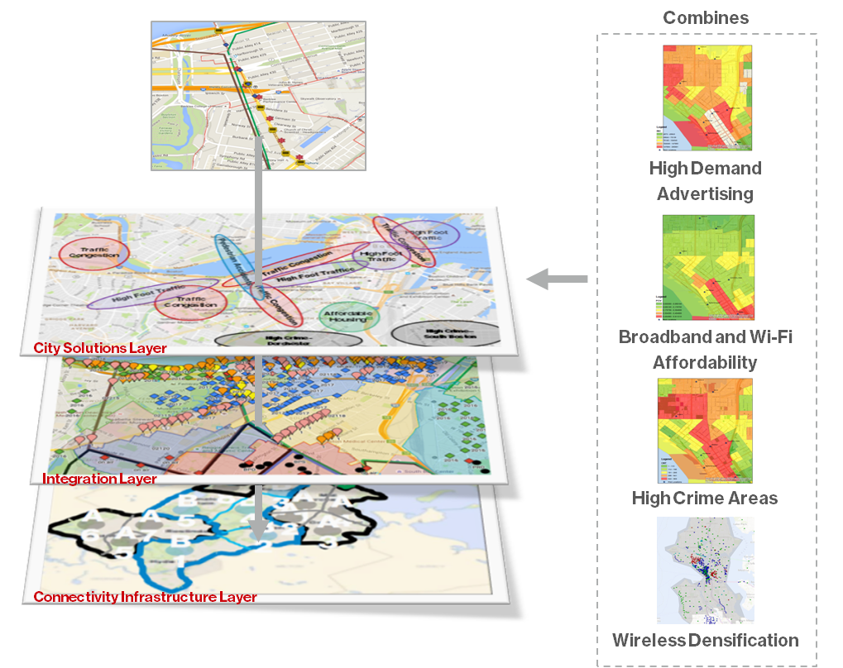
Begin with City’s key issues.
Support via network & tech.
Avoid implementing technology in search of a problem
Single dig reduces cost & city disruption dramatically
Utilization of City sidewalks & key city assets
Inclusive of city’s ecosystem with holistic architecture to minimize risk
Security & data privacy at core

Slide 9
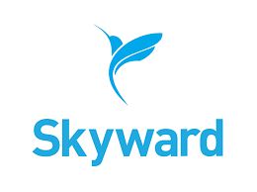
Investment in technology
Connectivity
Smart communities
Kiosk
Fleet
Advertising
Drone

Slide 10
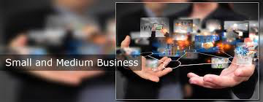
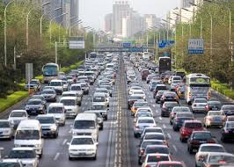
Public Private Partnership between cities and Tech .
Non Exclusive Partnerships.
Tech Co. Investment in City
Partnership vs. Vendor.
TRAFFIC
City & Partners on Same Side of the Table to Address Citizen Issues & Deliver Solutions

Slide 11
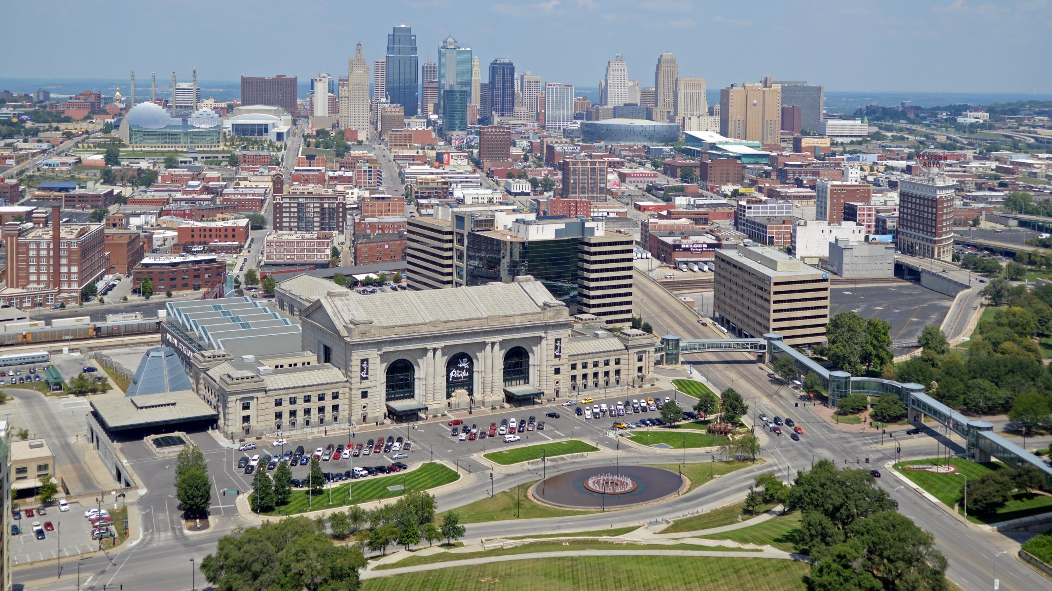
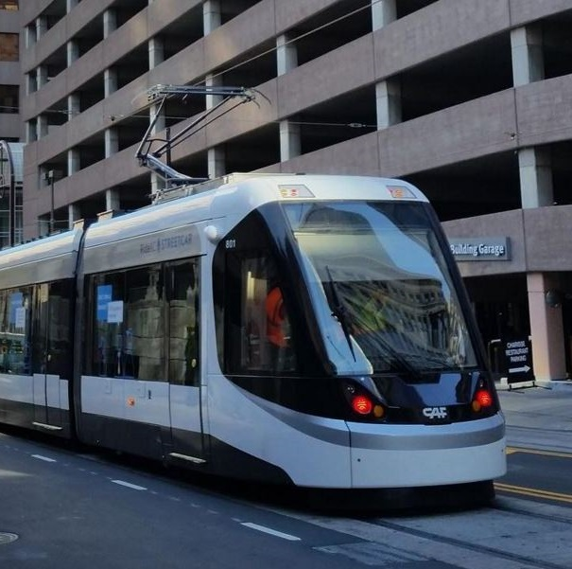
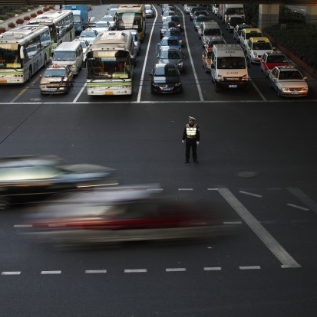
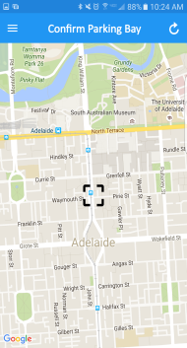
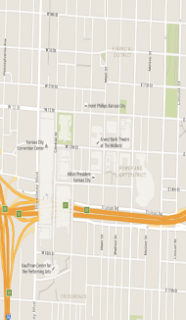
Kansas City: Use Cases
Lighting Control
Public Safety
Traffic Analytics
Smart Parking

Slide 12
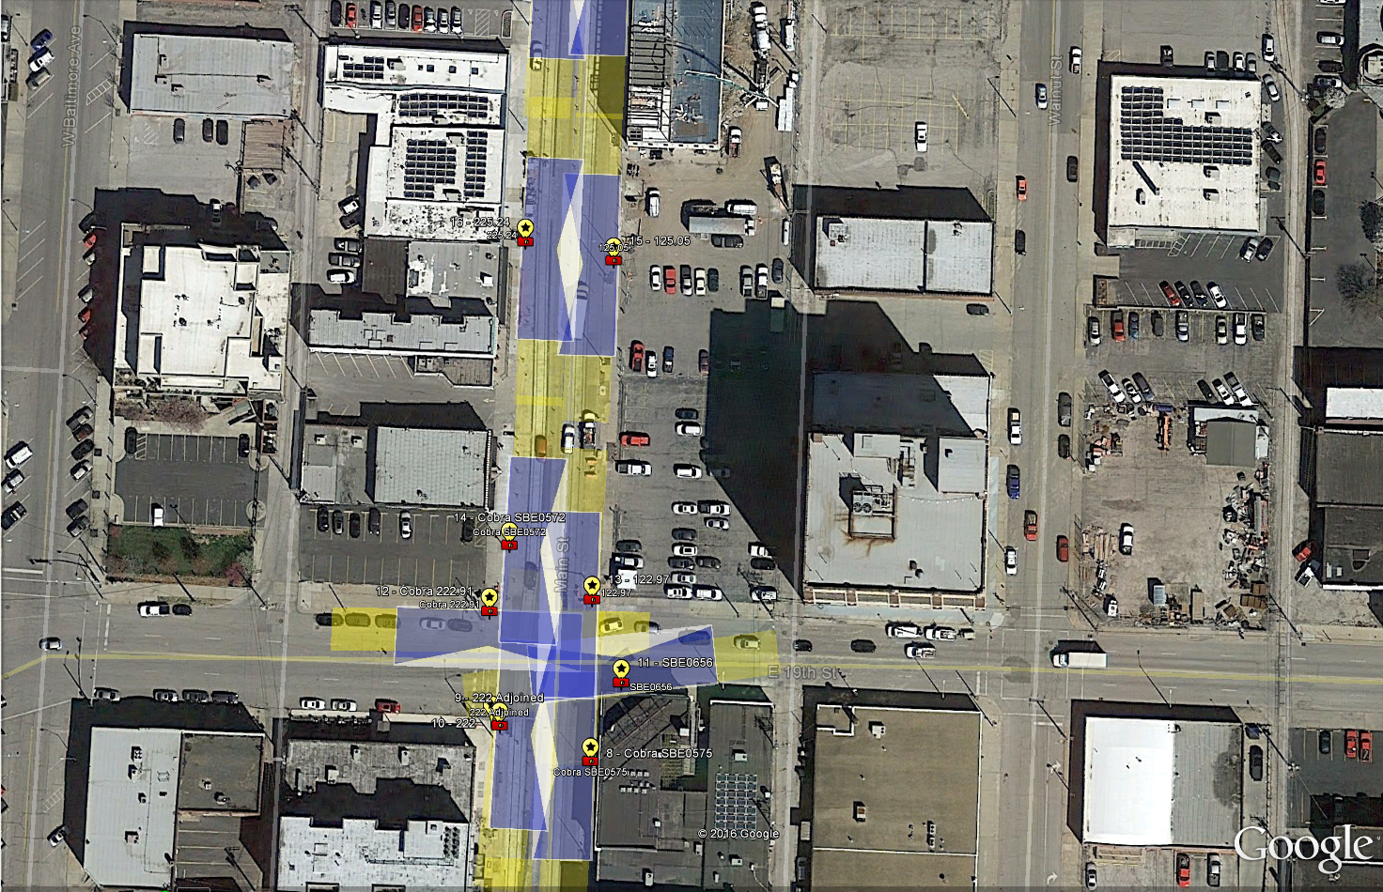
Kansas City: Solution Design
195 Core Nodes & 125 Video Nodes
Notes:
195 Core Nodes & fixtures along 2.2 mile stretch converted to smart LED’s
125 Multi-Sensor Nodes will cover 90% of streetcar line
Counts vehicle going through the one-way road
Detects stopped objects on the streetcar tracks
Integrated into Genetec VMS system

Slide 13
Washington DC: Use Cases
Lighting Control
Security
Traffic Analytics
Smart Parking

Slide 14
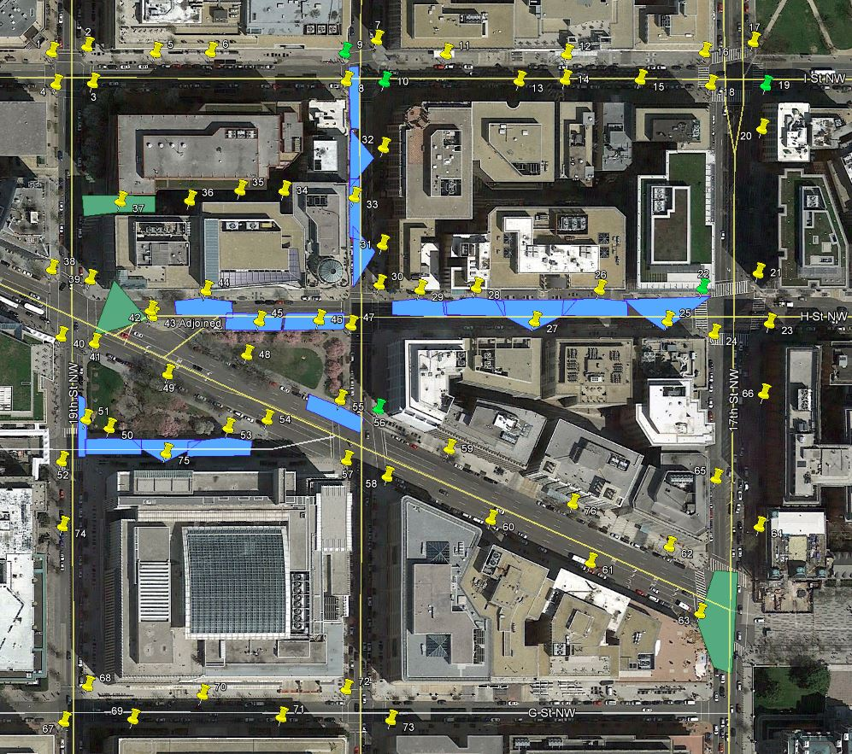
Washington DC: Solution Design
80 Core Nodes & 20 Video Nodes
Notes:
80 External Core Nodes
20 Video Nodes

Slide 15
Question & Answer
Closing Remarks

